Slide 1
Layout of speechecker

Slide 2
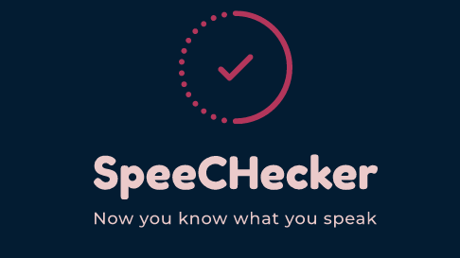

Slide 3
menu
Word count
Speech to text
Text to speech
Talk to me

Slide 4
Word count
Word count
Start
Stop
Result:

Slide 5
Speech to text
Speech to text
START
STOP
TEXT AREA

Slide 6
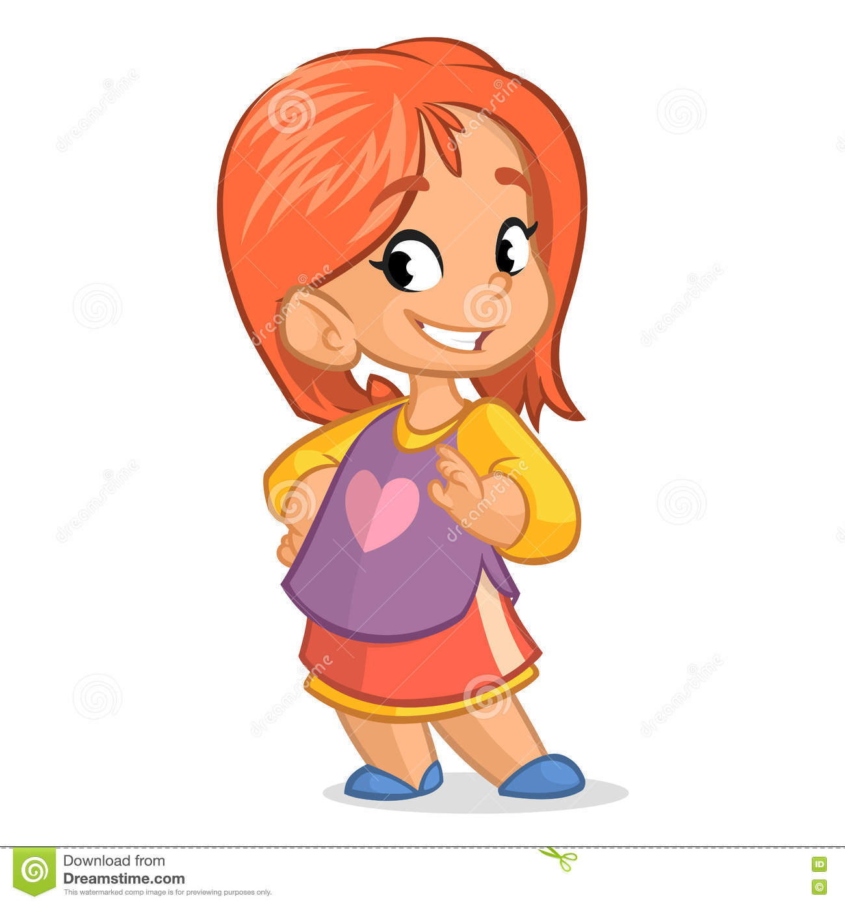
Talk to me
Audio files
Talk to me
Record

